Slide 1
CONNECT
LEARN
STRENGTHEN
ADVOCATE
Notes:
Speakers introduce themselves

Slide 2
OUR MISSION
Greater Virginia WAHN is committed to the development of women and allies in affordable housing through partnership, education, and service across the Commonwealth of Virginia.
Notes:
Talk about national parent organization a little and then the need for VA to have a chapter. Then talk about when we were formed and how far we are. Baby but boy have we done a lot.

Slide 3
OUR VISION
Advancing affordable housing through a strong network of women and allies across the Commonwealth of Virginia.
Notes:
Talk about our events and planned ambassador program

Slide 4
WHY ARE WE HERE TODAY?
Introduce GVA WAHN
Encourage the commission to utilize GVA WAHN to further women in housing and advocate for affordable housing in the Commonwealth.
Notes:
Present information

Slide 5
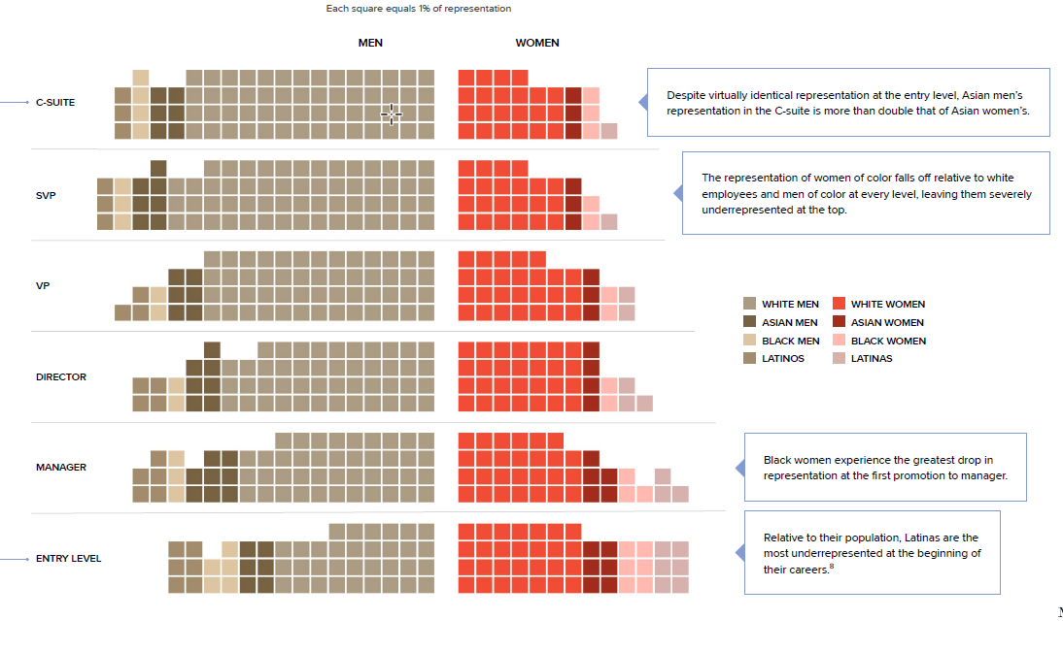
OUR WHY – A NATIONAL LOOK
Notes:
This is a look at the 2024 Corporate pipeline. Women remain under represented and this gap persists regardless of race and ethnicity. Even though women make up a greater number of people in the work force they are grossly under represented in the housing industry as a whole. Virginia is no different.

Slide 6
OUR WHY – A VIRGINIA LOOK
Occupation | Virginia total * | % Male* | % Female*
Industry Total | 725,008 | 54.3 | 45.7
Management | 459,020 | 58.7 | 41.3
Business/Finance | 265,988 | 46.7 | 53.3
Architecture/Engineering | 87,396 | 83.3 | 16.7
Office/Admin Support | 304,653 | 25.9 | 74.1
Construction/Extraction | 146,657 | 96.3 | 3.7
*Estimated
Occupation | Virginia total * | % Male* | % Female*
Industry Total | 725,008 | 54.3 | 45.7
Management | 459,020 | 58.7 | 41.3
Business/Finance | 265,988 | 46.7 | 53.3
Architecture/Engineering | 87,396 | 83.3 | 16.7
Office/Admin Support | 304,653 | 25.9 | 74.1
Construction/Extraction | 146,657 | 96.3 | 3.7
*Estimated*Estimated
Occupation Virginia total * % Male* % Female*
Based on 2022 Census Data
Notes:
Present information on slide

Slide 7
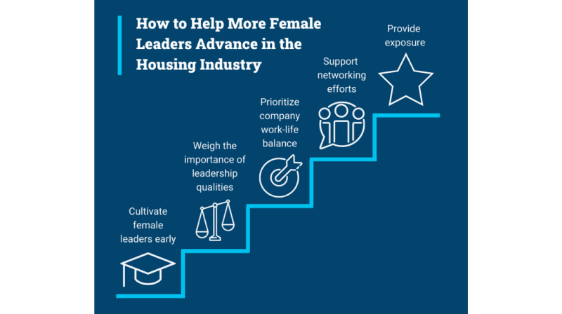
ROAD MAP TO REMOVE BARRIERS
Source: Harvard Report sponsored by Freddie Mac
Notes:
Given that women account for less than 2% of CEOs and fewer than 20% of executive board members in financial services companies worldwide, according to an International Monetary Fund (IMF) reportmale allies are essential in helping to close this gap.
A closer look at the traditional gender roles within the mortgage and housing industries might tell us how we got here. Mortgage lending in particular is a sales-driven business model, with men traditionally seeking out the production-oriented roles and women gravitating toward operations, quality control, and customer service—roles demanding problem solving and attention to detail, but typically not a path to the top positions. Which explains the numbers we saw in the previous slide.
Since the financial collapse of 2007, the industry has shifted from production quantity to production quality, with more attention on superior customer service, professionalism, open communication, and on strong business and capital markets experience
While women are vastly underrepresented in the upper ranks of the industry, they account for over half of the entry-level workforce, according to the IMF study. This poses the question of what’s disrupting their career paths. A forthcoming Harvard Report sponsored by Freddie Mac points out that many women are either opting out of the jobs that tend to feed into the higher-level positions or out of the industry entirely. Examining the reasons behind these obstacles—even those that seem self-imposed on the surface—can provide a roadmap for actions we can take. And that is what GVA WAHN intends to do.

Slide 8
GVA WAHN Committees
Events
Impact
Ambassador
Membership
Communications
Professional Growth
Sponsorship
Allyship
Notes:
Using the roadmap and other sources GVA WAHN created committees to help further the mission. Mention we have 9 board members and 3 committees, and one official ally
Discuss Committees. End with Ally ship.

Slide 9
ALLYSHIP
Promote Women Like the Future Depends on It
A significant talent shortage could be looming for the financial services sector—a 2018 study by Korn Ferry projects that a lack of qualified workers could result in $435 billion in unrealized economic output in the U.S. by 2030.
Competition for strong talent could become fierce, and companies of all sizes should be opening doors for women into leadership and attracting young women into the industry—particularly since now over half of all college graduates are female.
Keep in mind, female senior leadership increases threefold for each woman added to the executive ranks, according to a Deloitte Study . The case for male leaders to recognize and act on their role in this undertaking has never been stronger.
Notes:
According to multiple studies done by Freddie Mac. Men and women at financial services companies often start out in fairly equal numbers. But men still dominate leadership positions, holding over 80% of roles with profit-and-loss responsibility. The consequences of this disparity hurt both women and the future of the industry, since numerous studies highlight that companies with gender diverse executive teams see greater profits and attract better talent.
Both men and women benefit from mentors and sponsors as they advance their careers, whether their supporters are men or women. But the raw numbers tell us that with men dominating executive roles in financial services, their advocacy and inclusion is critical in getting women into the higher ranks. READ SLIDE That is why allyship is so important.

Slide 10
GVA WAHN 2024 Accomplishments
Obtained State Certification and 501(c)3 from IRS
Registered with VA Department of Agriculture
Participated in 3 Statewide Conferences and one National Conference
Co-sponsored a meet and greet happy hour
Multiple speaking events
Helped raise funds for affordable housing non-profit

Slide 11
GVA WAHN PLAN 2025
4 Lunch and learn events
At least of 2 networking event
Quarterly membership calls
Multiple conferences
Ambassador program
Mentorship program
Events to benefit Virginia affordable housing

Slide 12
Website
LinkedIn
Website
LinkedIn
CONNECT
LEARN
STRENGTHEN
ADVOCATE
Notes:
Together we can make the housing industry stronger. Join us or join both in the advancement of women in affordable housing. Thank you.

